Slide 1
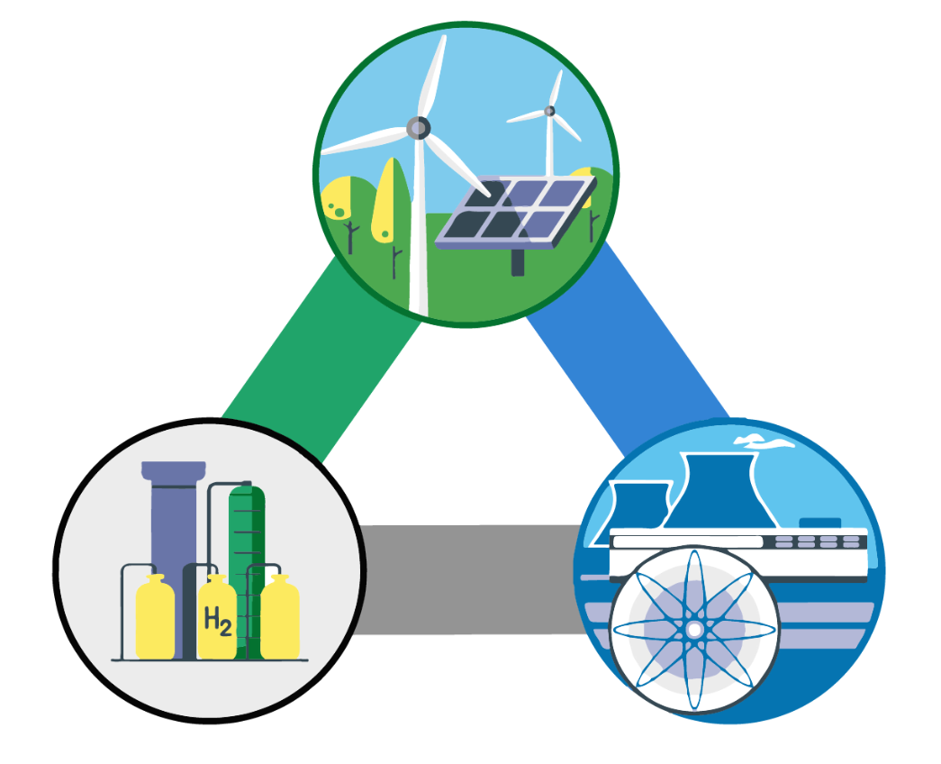
Integrating Nuclear and Renewable Energy Sources (NR-HES)
Joseph Lee Adria Peterkin Pedro Vicente

Slide 2




This presentation will cover the following:
The Problem
The Solution
System Modeling
Economic
Evaluation
Notes:
In this presentation, we will first analyze the problem arising from growing renewable penetration, explain our solution, explain how we modeled our system, and finally go over the economic evaluation to find if its practical or viable

Slide 3
The issue with the current energy market

Slide 4
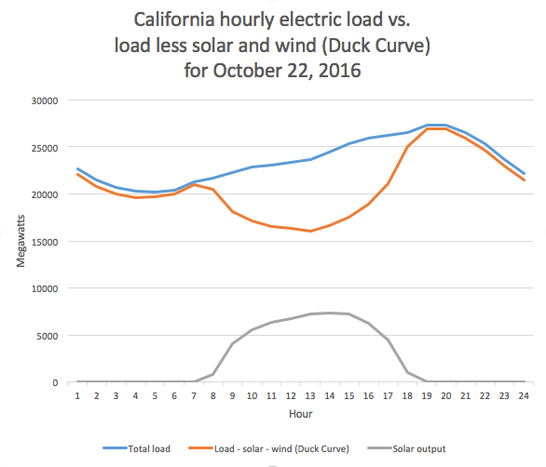
Renewable Energy is Causing Fluctuations in The Energy Demand Curve
Total Demand
Net Demand
Renewable Demand
California energy demand (Oct 22, 2016)
Notes:
With a growing penetration of renewable energy within California, the electrical demand or load has become more volatile. This graph here presents California’s hourly energy demand. This blue line is the typical energy load which is fairly constant but if we subtract out the energy load supplied by renewables, we obtain this curve which clearly fluctuates a lot more.

Slide 5
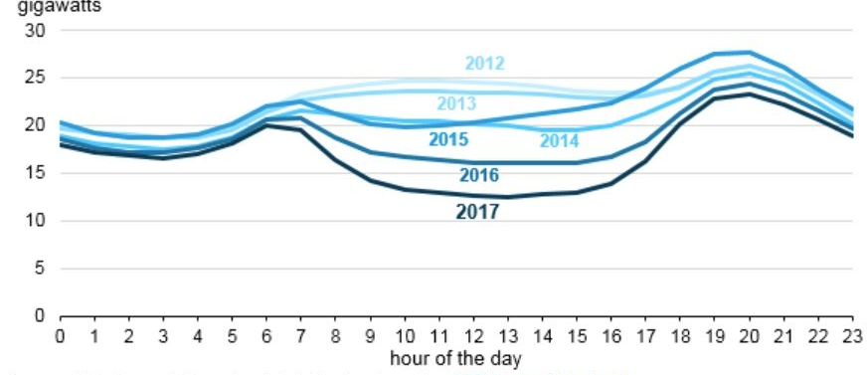
Energy Fluctuations are Increasing Through the Years
Changes in Net Demand - Renewables in March (2017, California ISO)
Notes:
As we can see, this well has only been increasing over the years as a result of greater solar generation within california

Slide 6

The Current Solutions are not sustainable
No Load Following: Electricity is sold at a loss
Excess Base-load Energy Supply
Energy Demand
Base-load Energy Supply
Notes:
This growing well negatively affects the economic feasibility of base load power plants like nuclear which can not easily change its power output or load follow. In order to meet this demand, this is what the base load supply must look like in a simplified sense however, all of this is sold at a lower value

Slide 7
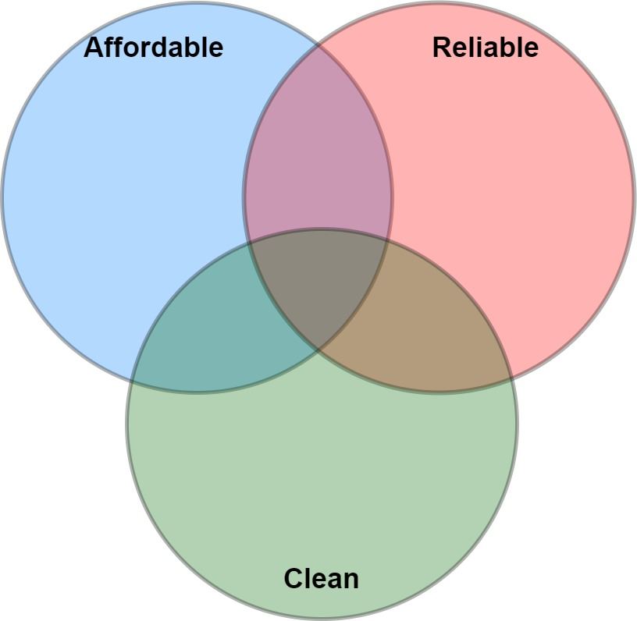

A Viable Solution Should Meet Three Basic Requirements
Affordability
Low base and operating costs
Fossil Fuels
Diesel Generators
Reliability
Controllable Energy Output
Hydro
Nuclear
Wind Solar
Cleanliness
Minimal Environmental Impact
Notes:
So our capstone project looks to find an ideal energy production that meets three important requirements: affordability, reliability, and cleanliness. As stated before, there currently is no ideal energy production method

Slide 8
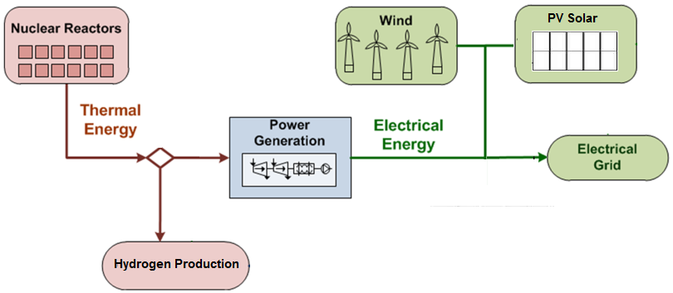
The Nuclear-Renewable Hybrid Energy System (NR-HES) is the Solution
Affordability
Advanced Reactors are cheaper than modern Reactors
Reliability (load following)
Excess energy goes to hydrogen plant
Cleanliness
No carbon emission during operation
NR-HES: Connection between Renewables, an Advanced Reactor, and a Hydrogen Plant
Notes:
Instead of looking for the answer with one production method, we look for a novel solution that combines three different components. This connection is called the hybrid system and it reaps the benefit of the different energy production method without the negatives. This combines renewables, nuclear energy, and hydrogen energy production.
Affordability is achieved using advanced nuclear reactors which are cheaper and safer. Reliability is achieved by sending excess energy to the hydrogen plant, and the renewables/nuclear provide clean carbon free

Slide 9
Our technological solution to the energy issue

Slide 10
The NR-HES can Vary the Electrical Output to Match Changing Demands
Energy Demand
High Energy Demand
Low Energy Demand
Electricity Production
Thermal
Energy
Hydrogen Production
Notes:
The idea of how this works is very simple. We have a set amount of thermal energy available and we can allot this thermal energy to electricity production or hydrogen production depending on the electricity demand. So we can split this thermal energy is as such in times of of high electricity demand, moderate demand, and low demand.

Slide 11
The Secondary Industry Process uses the Excess Energy
Excess Energy Supply to Hydrogen
Energy Demand due to Renewables
Electricity Production by Nuclear

Slide 12
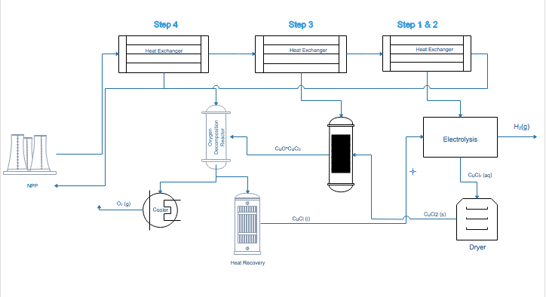
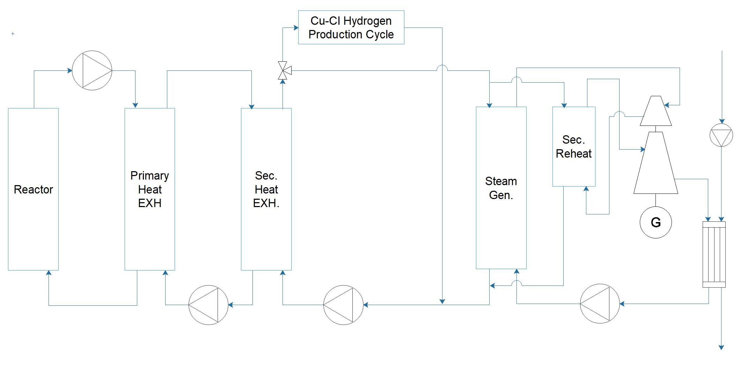
Interconnection of the Nuclear and Hydrogen System

Slide 13
The characterization and modeling of our NR-HES

Slide 14

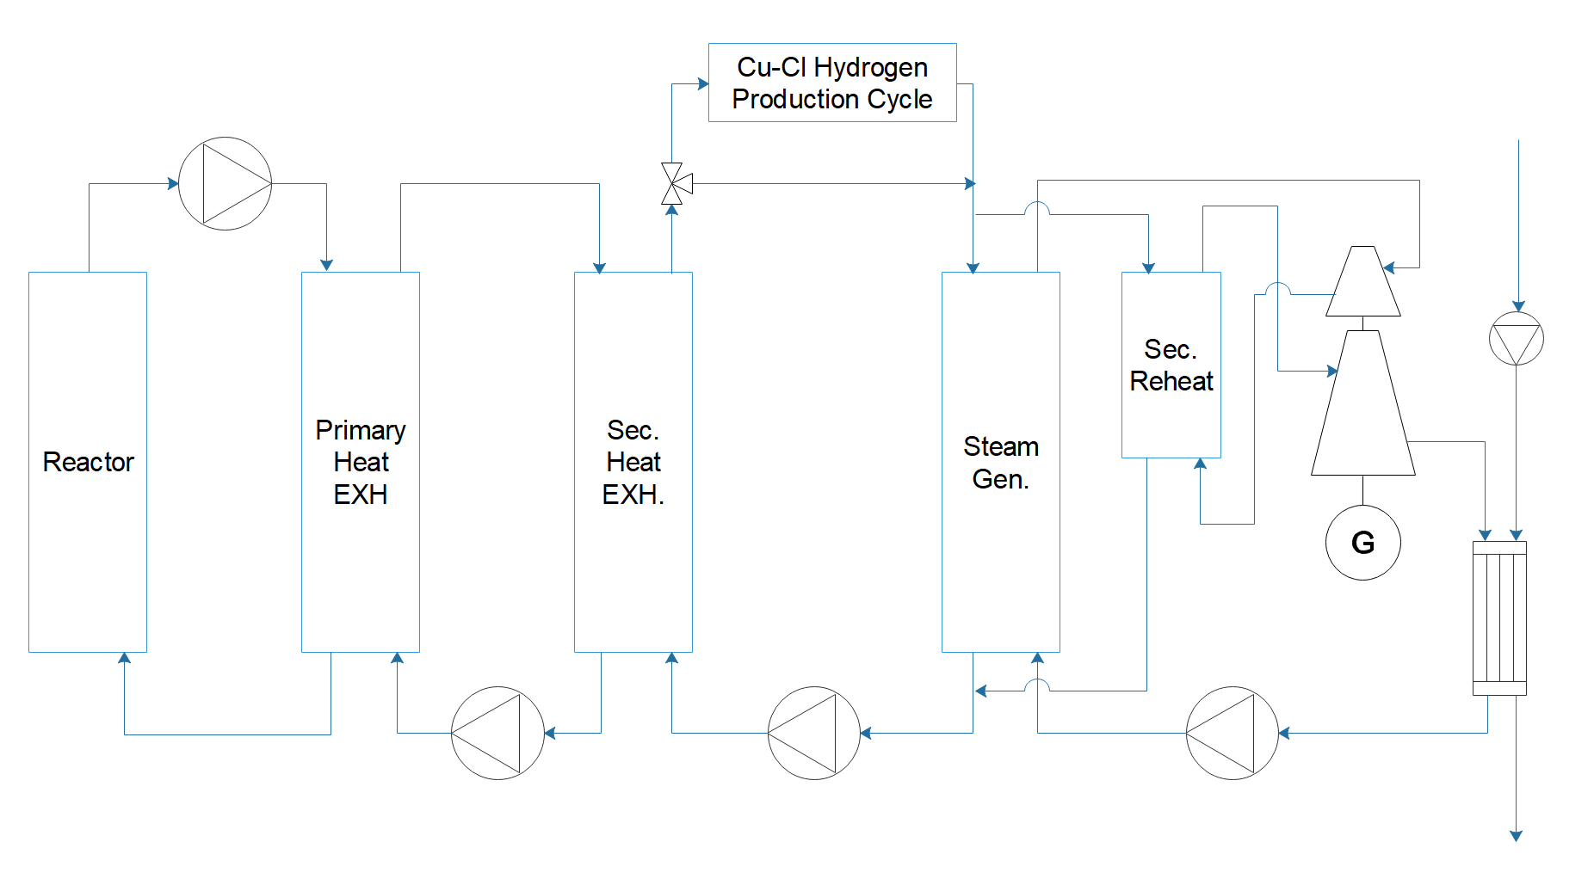


Modeling the NR-HES
Component time dependence
Reactor and Hydrogen Thermodynamic Behavior
Reactor and Secondary Process Selection
Notes:
When designing our model, we first selected our reactor and secondary industry process which was a MSR with a supercritical rankine cycle and a hydrogen production plant. We then analyzed the thermodynamic behavior systems to identify factors affecting electricity and hydrogen production. Finally, we looked into the time dependent behavior of independent components.

Slide 15
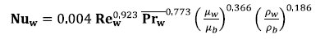



Using MATLAB to find a Correlation Between Molten Salt and Steam Flow Rate
Q=A*h*ΔT
T_hot=T_cold+Q/(A*h)
Heat input from Partial Molten Salt
Flow rate of Steam
Electricity Output
Notes:
From there we moved onto creating a MATLAB code. We identified an expression for the heat transfer coefficient for supercritical water flow in vertical bare tubes. This expression takes in inputs like the amount of heat put into the steam generator, steam inlet temperature, and mass flow rate.

Slide 16
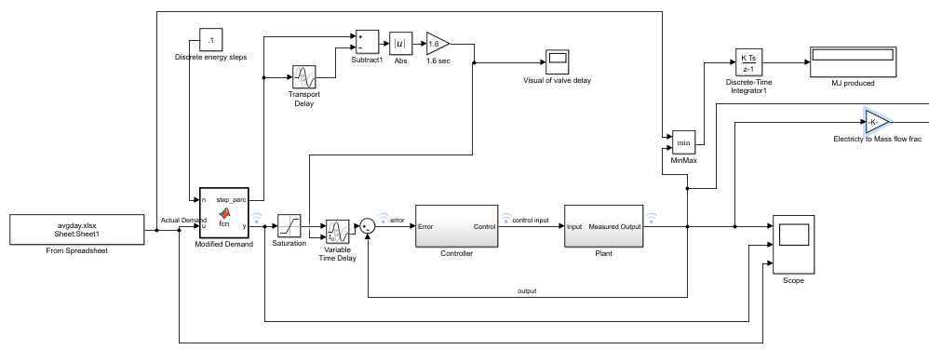
SIMULINK identified electricity and hydrogen output
Valve Response Delay
Demand Input
Flow Stabilization
Electricity to Mass Flow

Slide 17
An economic evaluation of the model
Notes:
SHOWCASE:
Know I will talk to you about the economics of our system and model.
Economics of our system and model
Energy industry - energy generating methods
Evaluated in LCOE

Slide 18
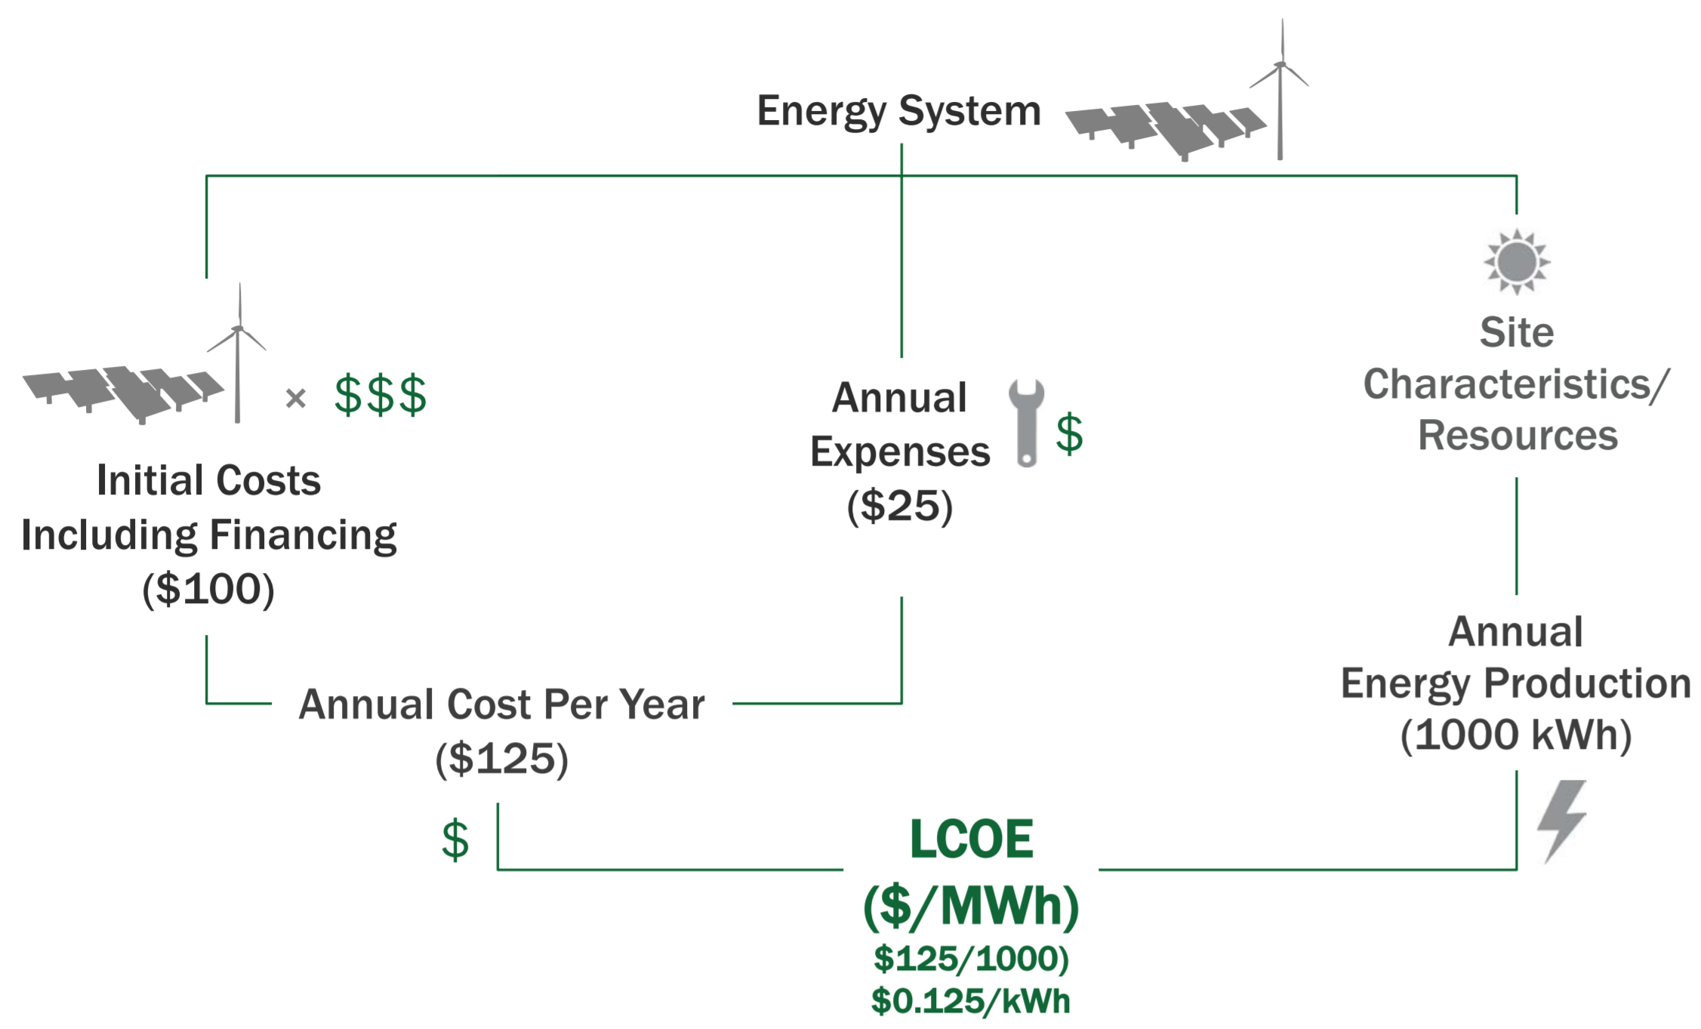
Economic Benefits - Levelized cost of Electricity
Notes:
SHOWCASE:
As you all know, the energy industry but more specifically the energy generation methods are evaluated by what is known as the levelized cost of electricity, the LCOE. Explained simply, the LCOE is the sum of the cost over the lifetime of the plant divided by it’s energy generation. Basically the lower the number the cheaper we are able to produce energy.
LCOE simply costs/energy generation
Project feasibility not only technology but also economically competitive
Our scenario imagines both technology are already in existence
For our project, calculated costs and energy
For any project to be feasible it does not only have to be technologically ready but also economically competitive with other generating sources. For this example, we calculate everything imagining we have both technologies ready. This means, very broadly, that to calculate the LCOE for our system we gathered the initial costs or overnight costs, including capital cost and annual expenses needed to operate the different technologies. We calculate the energy production for our molten salt reactor taking into account the thermal energy loss to the hydrogen plant.

Slide 19
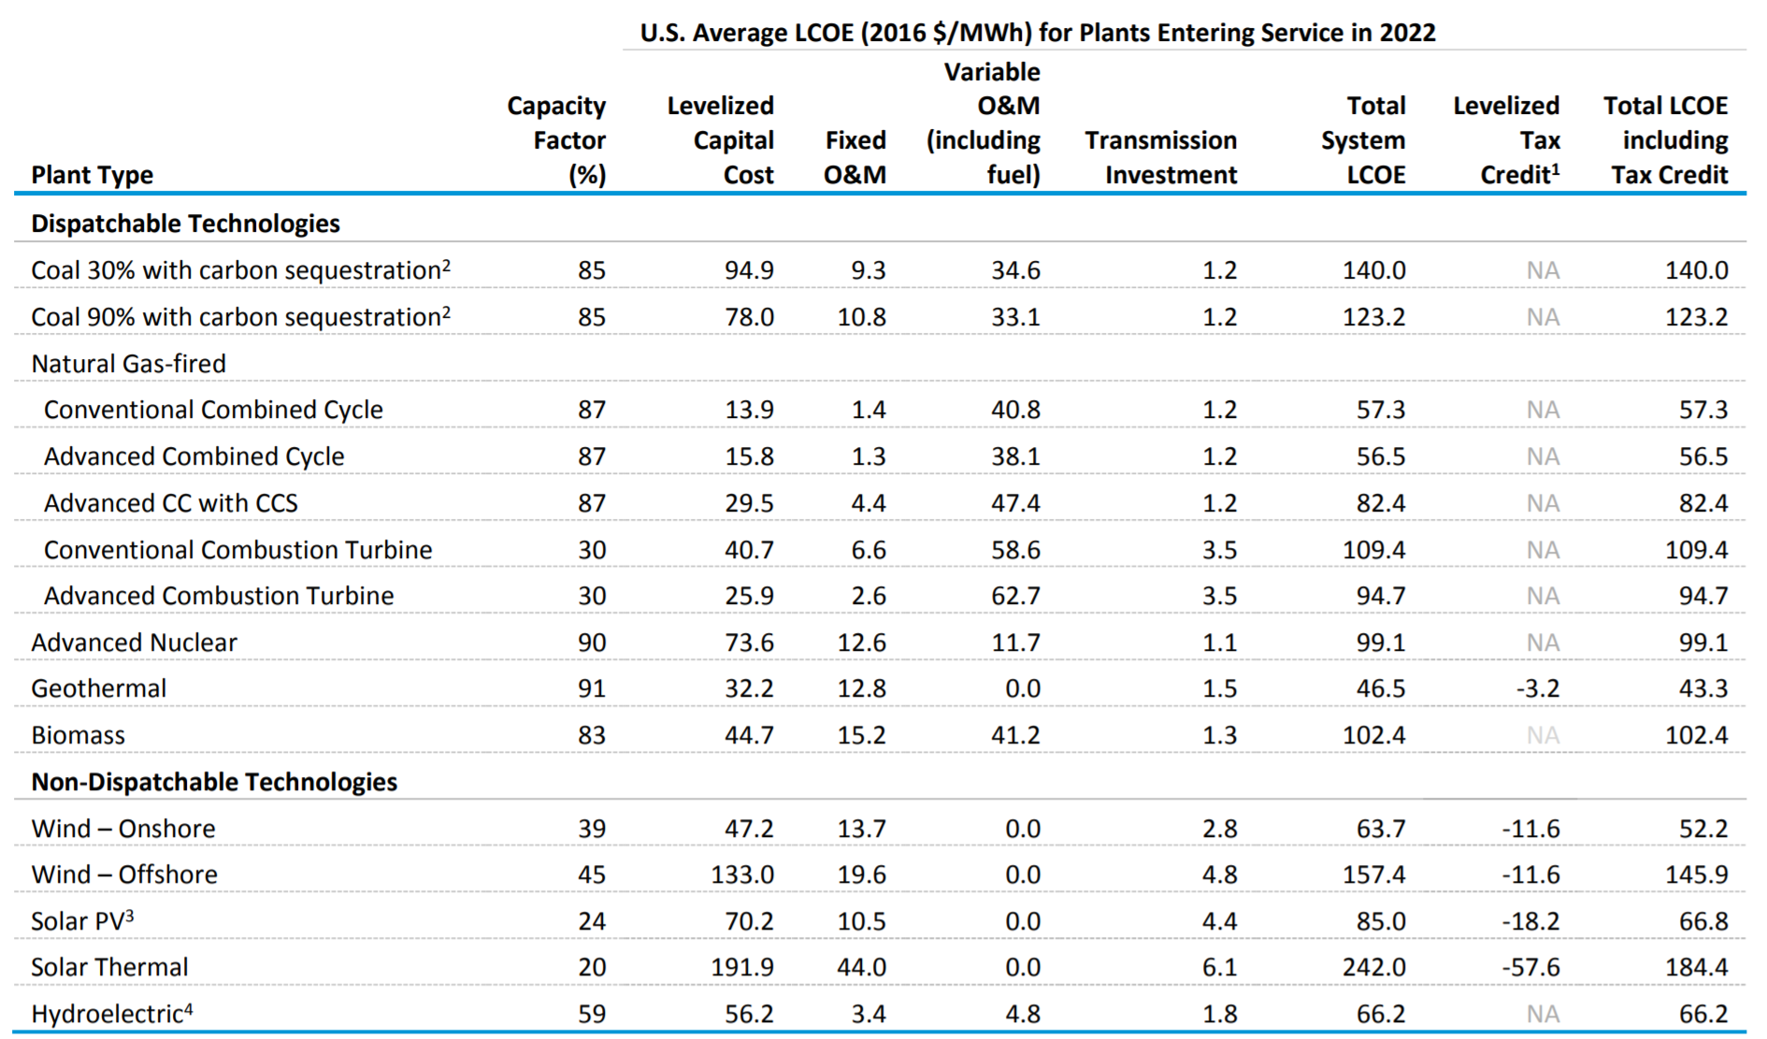
Economics - Comparing LCOE
Notes:
SHOWCASE:
To give a little context, this table represents the forecasted LCOE for plants entering service in 2022. For an energy project to be feasible not only does the technology need to be ready but it also needs to be economically competitive which in our case the main competitor in the future are envision to be natural gas, which has an LCOE of 82.4 dollars per MWh. It is also noticeable that renewables are not affordable relative to natural gas due to its unreliability.
To give a little context, this table represents the forecasted LCOE
Comparison and popularity - natural gas 56.5
Nuclear 99.1
Our goal is NR-HES, take into consideration wind and solar
for different energy generating sources that are entering service in 2022. For comparison purposes and given the current popularity of natural gas, we will focus on advanced combined cycle with carbon capture sequestration which has a LCOE of 56.5. It is worth mentioning that the US. Energy administration puts advance nuclear systems at 99.1. Since our systems goal is to make a nuclear-renewable system more affordable and efficient, we will also take into consideration Wind – onshore and solar PV.

Slide 20
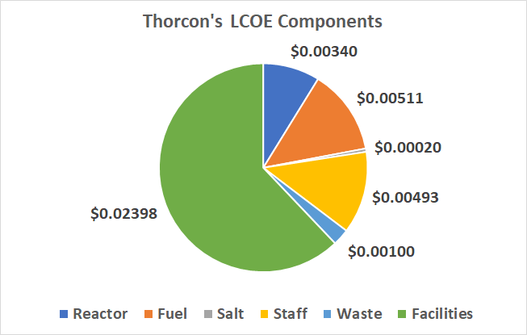
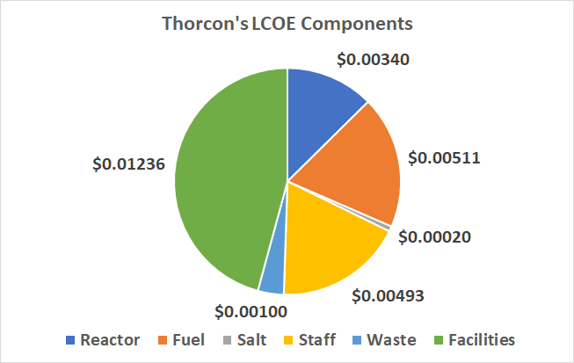
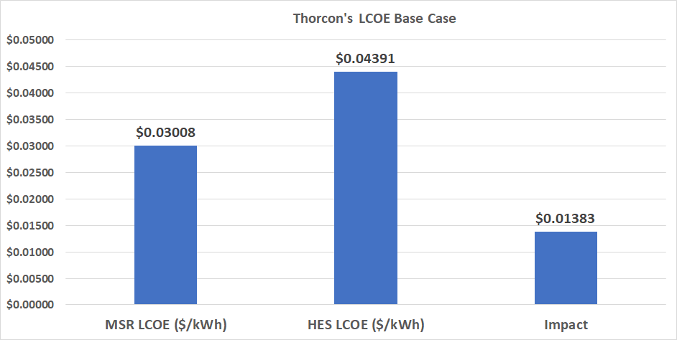
Impact on Thorcon’s LCOE after integrating a 34 ton/day hydrogen production plant
Notes:
SHOWCASE:
As mentioned before, our system focuses on Thorcons MSR, after some calculations taking into some aspects like the reactor, fuel, salt, staff, waste processing and the facility the resulting LCOE is about 3 cents per kWh. After incorporating a 34 ton/day hydrogen facility we integrated the overnight costs and took into account the thermal energy and electricity loss. This resulted in an additional 1.3 cents for the overall LCOE.
As mentioned before, our system focuses on Thorcons MSR, after some calculations taking into some aspects like the reactor, fuel, salt, staff, waste processing and the facility the resulting LCOE is about 3 cents per kWh. After incorporating a 34 ton/day hydrogen facility we integrated the overnight costs and took into account the thermal energy and electricity loss. This resulted in an additional 1.3 cents for the overall LCOE.
Since we have a hydrogen production plant, in this example 34 tons per day plant, there is going to be some energy losses that need to be accounted for when calculating the new LCOE. After incorporating this energy loss and also the overnight costs of the hydrogen facility along with the capital cost, we have an increase of 1.3 cents per kWh resulting 4.3 cents per kWh

Slide 21
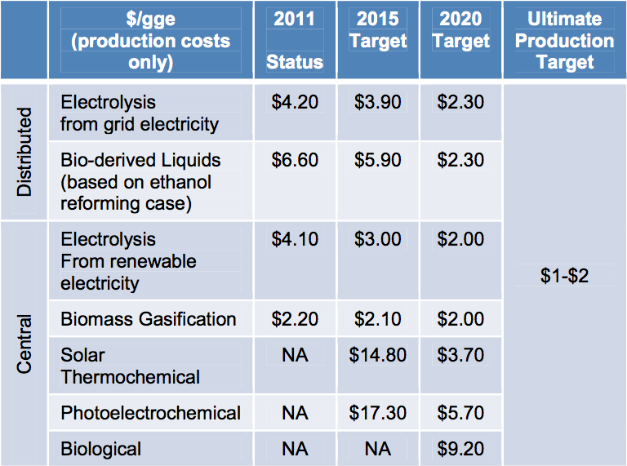
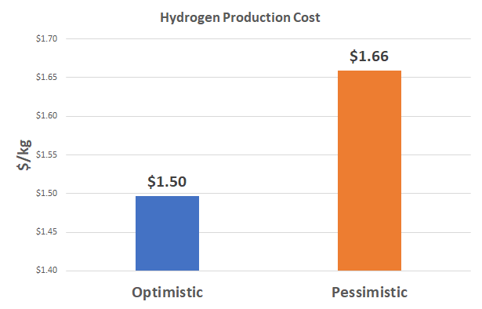
We are meeting DOE targeted Hydrogen Production Costs ($/kg)
Notes:
SHOWCASE
To take into account the benefits of having a secondary industry process, we first we looked into the hydrogen plant profitability. The DOE has targeted for thermochemical methods around 4 dollars/kg by 2020. For our plant we looked at the operating costs per year including raw materials and distribution costs all of which results in a hydrogen production cost of 1.66 dollars per kilogram in the worst case scenario meaning higher than anticipated operating costs which even in this case we manage to produce well within the targets.
via thermochemical methods within the ultimate production target from the DoE which is 1 to 2 $/gge. A gge is just 1.019 kg. Once having our overnight capital costs and the plant hydrogen production cost, and taking into account two scenarios. One in which we sell hydrogen at 16 /kg, which is the current selling price, and a 10$/kg which is the forecasted price, we integrated the profitability of the plant to the systems LCOE.
Hydrogen fuel prices range from $12.85 to more than $16 per kilogram (kg), but the most common price is $13.99 per kg (equivalent on a price per energy basis to $5.60 per gallon of gasoline)

Slide 22
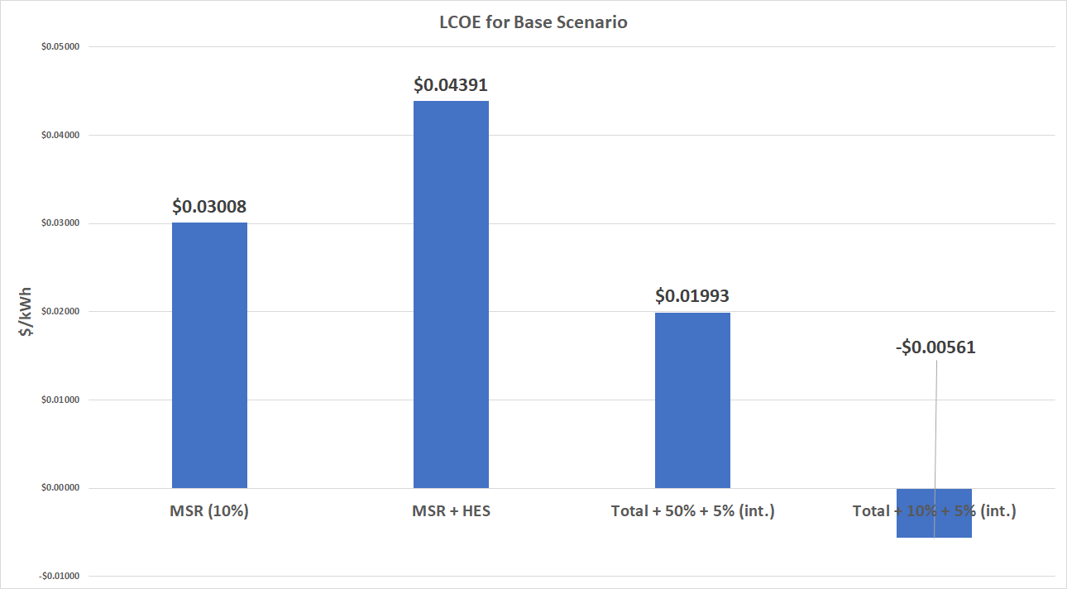
Even in a worst case scenario the hybrid energy system adds value
$0.01015
$0.03569
Notes:
SHOWCASE
After integrating the net profit into our system we calculate the new LCOE, for these we looked into two scenarios. One in which we took into account an extra 10% to account for any regulatory fees or technology integration costs that might arise unexpectly and a 50% extra just to provide an overestimation. In both cases we were able to achieve a lower and even a negative LCOE having savings ranging from 1 to 3 cents per kwh.
The results of these calculations are the following LCOE, from past slides the MSR alone LCOE is around 3 cents, once the hydrogen plant was integrated it rises to around 4 cents per kWh. In the worst case scenario after integrating costs and profitability the LCOE is only 2 cents in the base case it gets negative. What does negative mean, it means the out-year benefits are more than the initial investment

Slide 23
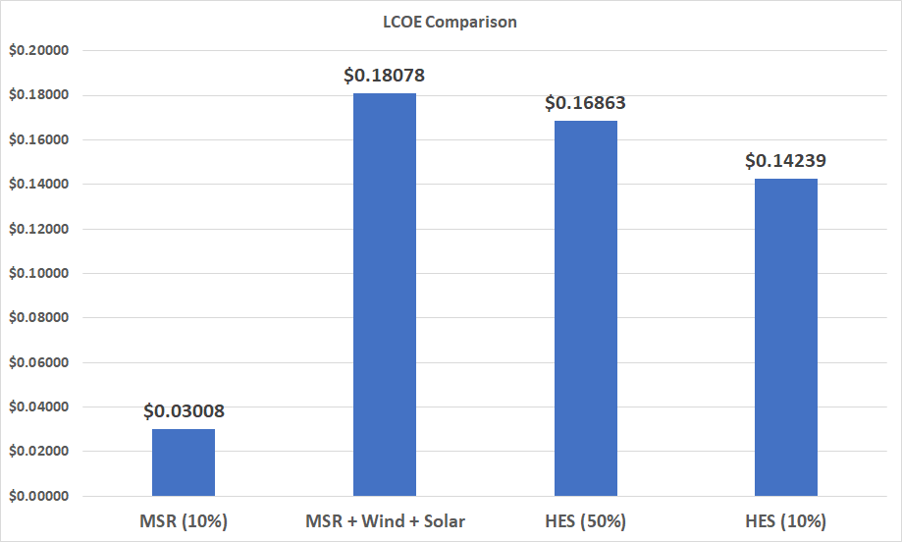
Nuclear-Renewable Hybrid Energy System LCOE
Notes:
Once integrating our systems LCOE with the projected LCOE for wind on shore and photovoltaic solar we also have savings across scenarios. This reflects the importance of having a secondary industry process to allow us to vary energy supply while using excess energy for the production of a commodity.

Slide 24
Conclusion
The current mode of energy production cannot support the grid nor the environment in the long term
Hybrid Energy Systems are important for achieving a clean and sustainable grid
The Nuclear-Hybrid Energy System is a clean and affordable solution to increasing grid volatility due to renewable penetration
The integration of a secondary industry process allows the nuclear reactor to “load follow” and to be more affordable.
Economic savings allow programs like California’s goal to reach 50% energy production from renewables to be economical.
Notes:
In conclusion instead of relying in GHG emitting fossil fuels like natural gas we can get the same reliability, affordability and flexibility with advance nuclear reactors and a hes. The big economic savings leave space for programs like California’s to introduce more renewables without having to also increase ghg emitting energy generating sources, increase imports or increase battery and storage capacity. Thank you, any questions?

Slide 25


Acknowledgements
Principal Investigator: Max Fratoni
The Nuclear Engineering Department
The Fung Institute

Slide 26
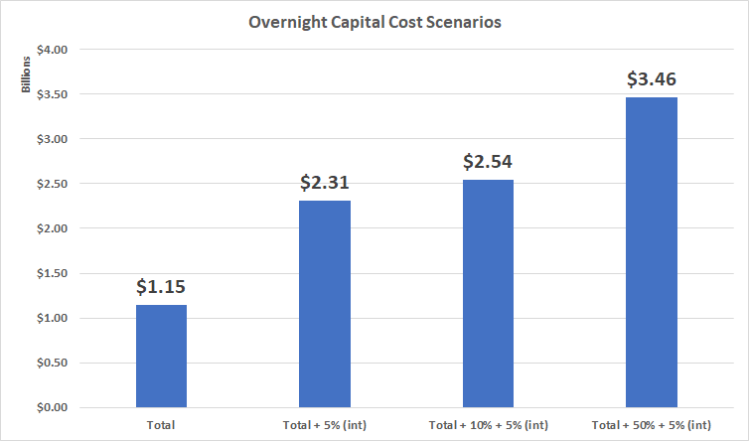
For our calculations we take three different scenarios to account for unexpected costs
Notes:
To be even more safer we calculated two more scenarios, a 10% and a 50% extra to take into account any licensing regulations fees and technology integration costs that may arise unexpectedly

Slide 27
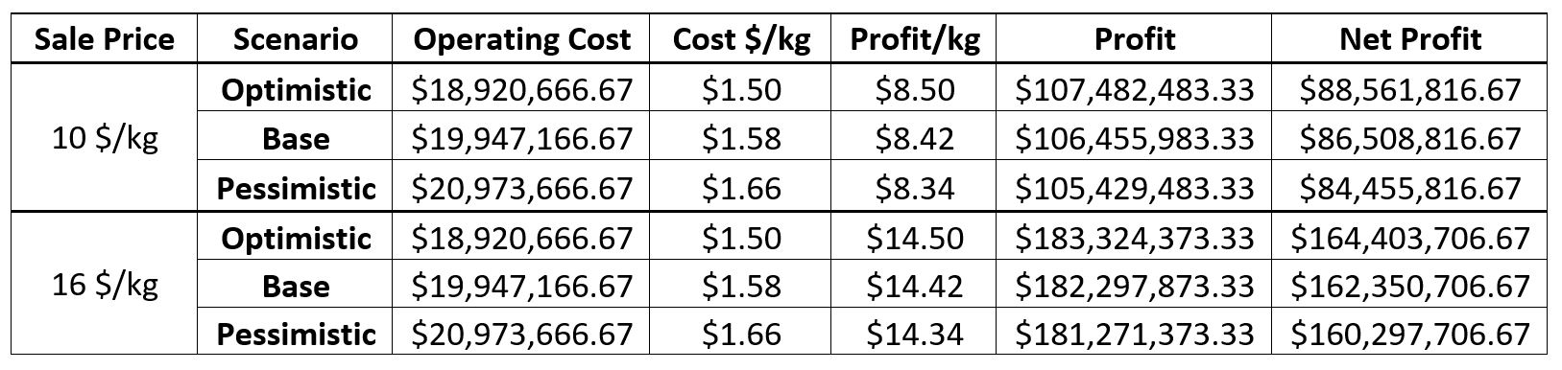
A.1. Hydrogen Plant Profitability

Slide 28
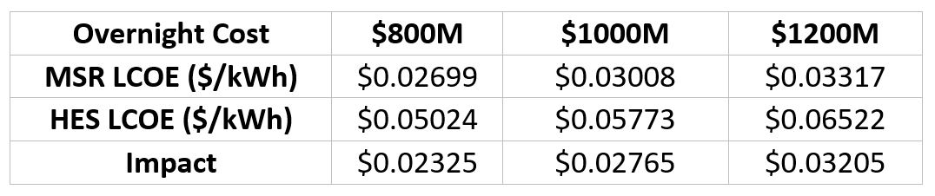
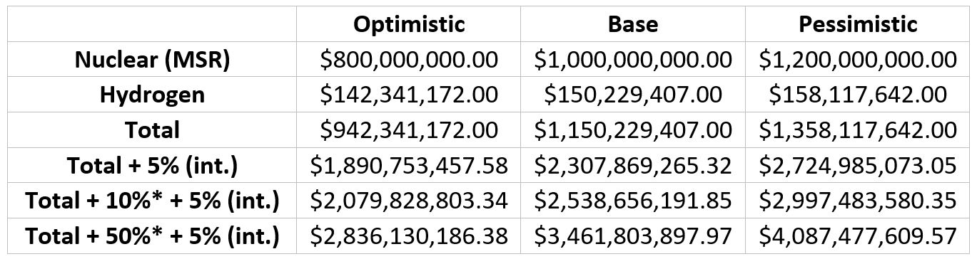
A.2. NR-HES

Slide 29
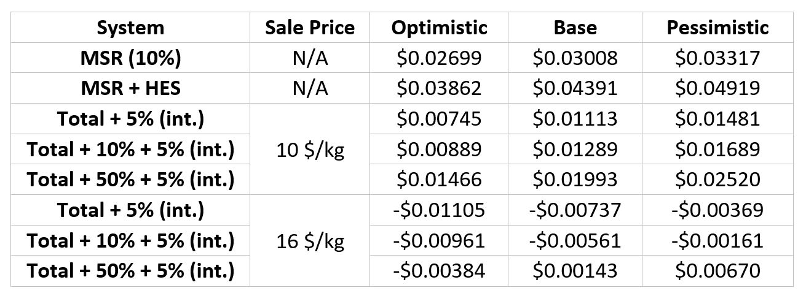
A.3. NR-HES LCOE for different scenarios

Slide 30
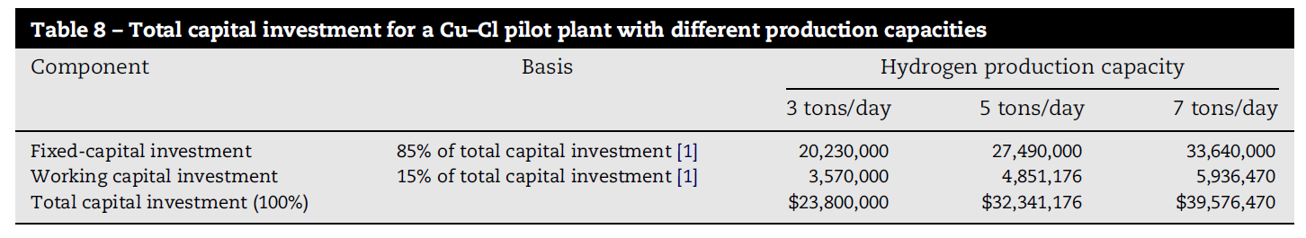
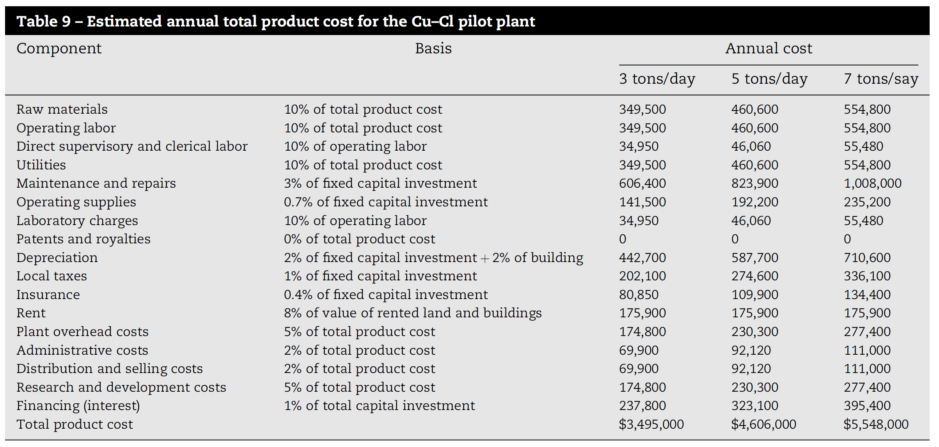
Hydrogen Plant Costs

Slide 31
Hydrogen Plant Annual Operating Cost

Slide 32
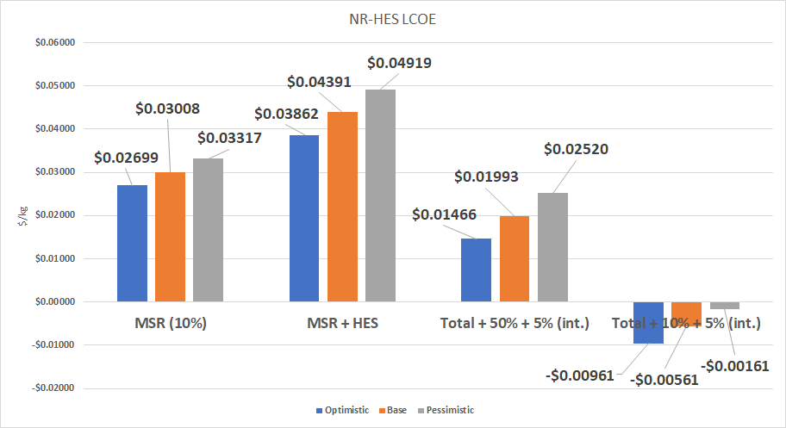
A.4. NR-HES for Different Scenarios

Slide 33
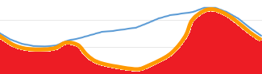
The Current Solutions are not sustainable
Compensating With Fossil Fuels: Increases carbon emissions
Standby Fossil Fuel Generators Energy Supply
Energy Demand
Base-load Energy Supply
Notes:
There are two solutions and neither of them are sustainable. The first is making up for the fluctuating demand with standby fossil fuel generators. While effective, this is a short term solution given increasing concerns of GHG emissions. On the other hand we could simply over produce and sell electricity at a loss but then cleaner energy sources like nuclear cannot compete.

Slide 34
Supercritical Steam Generator
Heat transfer correlation for supercritical water flow in vertical bare tubes
24 MPa,
mass fluxes from 200 to 1500 kg/m2s
heat fluxes up to 1250 kW/m2
Inlet temperatures from 320 to 350ºC.
±25% HTC

Slide 35
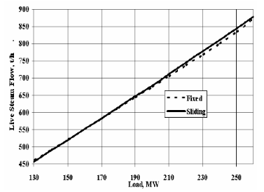
Sliding Pressure
this case, inlet turbine areas remain constant, and the
live steam pressures will naturally result, function of
the live steam flows (turbine loads)

Slide 36
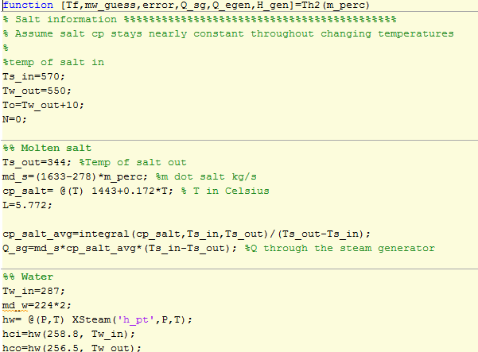

Our Model allows us to identify the hydrogen and electricity output of our NR-HES
Input
Simulink/Matlab
Output
Economics
Energy Production
Electricity Demand
Hydrogen Production
Notes:
So we combined all that information we talked about and used matlab and simulink to model our system. Using the characterization of the steam generator, we wrote a matlab code that would identify the system characteristics necessary to get electricity production to match the current demand. We then put that information along with how other components behaved into simulink (a graphical block coding program).
Once we have the system characterized, we can plug in an electricity load into this “black box” and that outputs the energy and hydrogen production. From that, we can evaluate the economics of this hybrid system. We took it one step further and altered the parameters within this black box until we optimized our output.

Slide 37
Using MATLAB to find a Correlation Between Molten Salt and Steam Flow Rate
Constrained
Q=A*h*ΔT
T_hot=T_cold+Q/(A*h)
Heat input from Partial Molten Salt
Flow rate of Steam
Electricity Output
Notes:
From there we moved onto creating a MATLAB code. We identified an expression for the heat transfer coefficient for supercritical water flow in vertical bare tubes. This expression takes in inputs like the amount of heat put into the steam generator, steam inlet temperature, and mass flow rate.

Slide 38
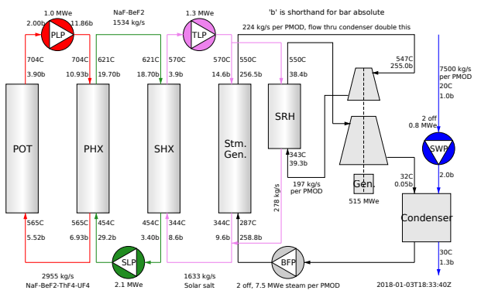
System Constraints
Notes:
We thought of a few constraints on our model. Here is the thorcon msr model which our system is based off of. First we constrained the inlet and outlet temperature of the molten salt from the steam generator such that our interconnection didn’t affect the primary/secondary loop. Second we constrained the steam outlet and inlet temperatures and pressures such that we are always operating in the supercritical regime

Slide 39
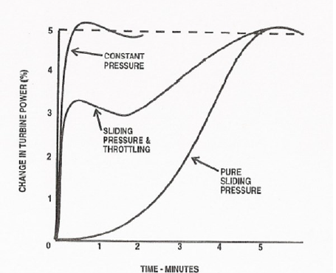
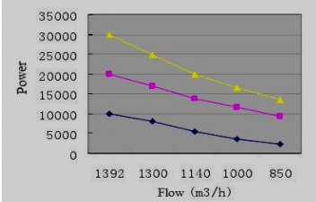
he fixed-pressure method is based on reducing the admission area of the first stage of the turbine by means of nozzle-governing valves
steam pressure in the boiler is maintained and a valve at the HP turbine inlet is used to reduce the pressure along the turbine steam expansion path. Valve control induces significant losses in the valve and reductions of the turbine efficiencies

Slide 40
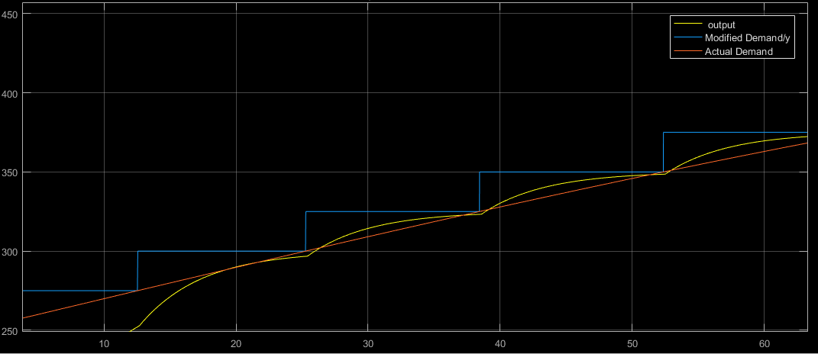
Example of Electricity Response
Electricity (MW)
Time (seconds)

Slide 41
Hydrogen CuCl Cycle
Step 1: Electrolysis Cell
2 CuCl (aq) + 2 HCl 2CuCl2 (aq) + H2 (g)
Step 2: Drying
CuCl2 (aq) CuCl2 (s)
Step 3: Hydrolysis reactor
2 CuCl2 (s) + H2O (g) CuOCuCl2 (s) + 2HCl (g)
Step 4: Oxygen Decomposition Reactor
CuOCuCl2 (s) 2CuCl (l) + O2 (g)

